Slide 1


EagleEye: Wearable Camera-based Person Identification in Crowded Urban Spaces
Juheon Yi¹, Sunghyun Choi², Youngki Lee¹
¹Seoul National University, ²Samsung Research Korea
ACM MobiCom 2020

Slide 2


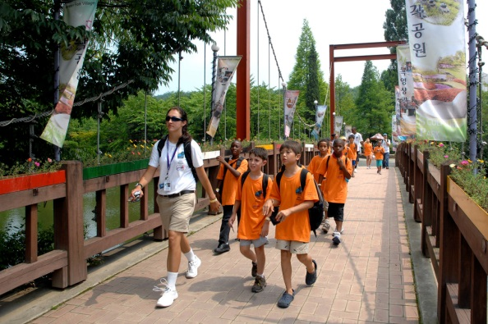
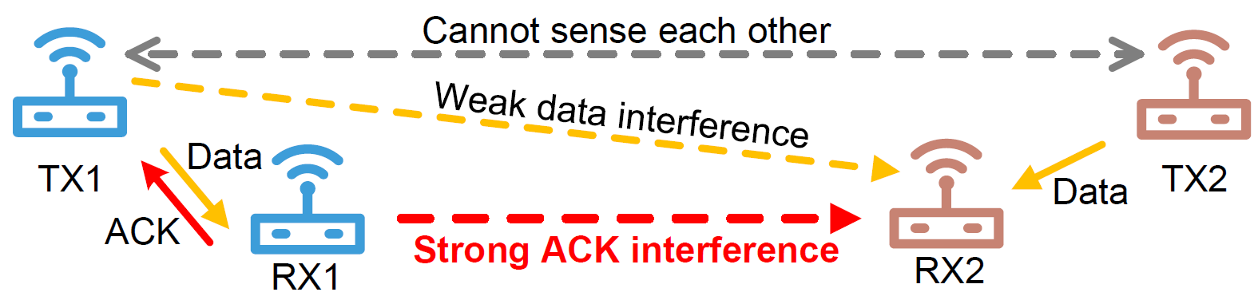
Needs for Robust Person Identification
Children counting in kindergarten field trips
Finding a crime suspect in crowded streets

Slide 3
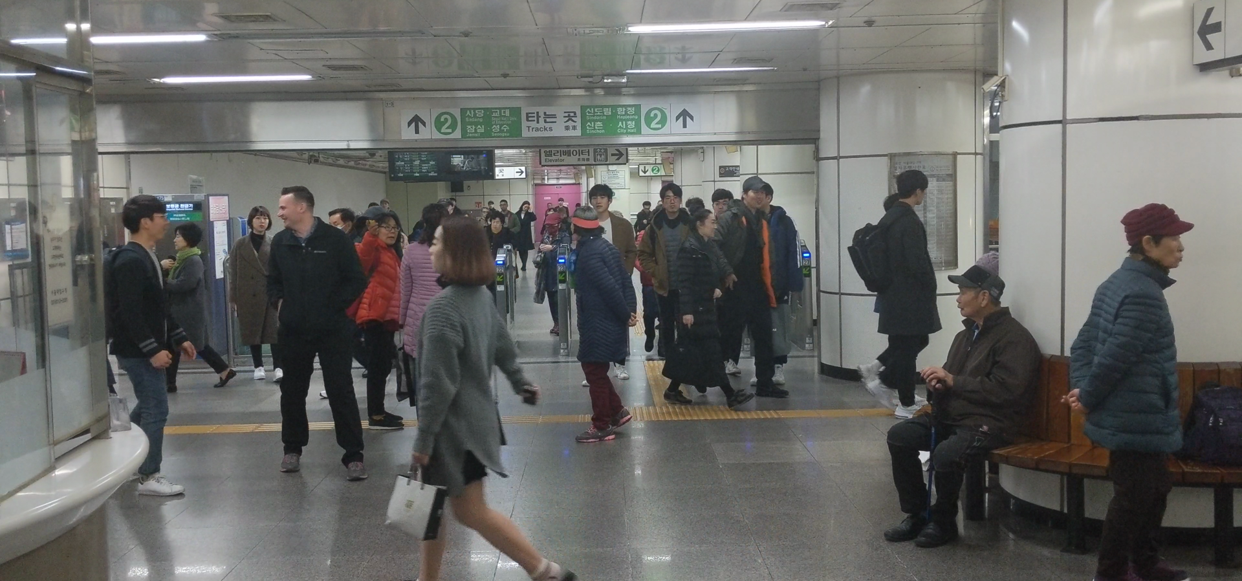

Humans: How Fast and Accurate?
Difficult due to large number of faces and their small sizes

Slide 4
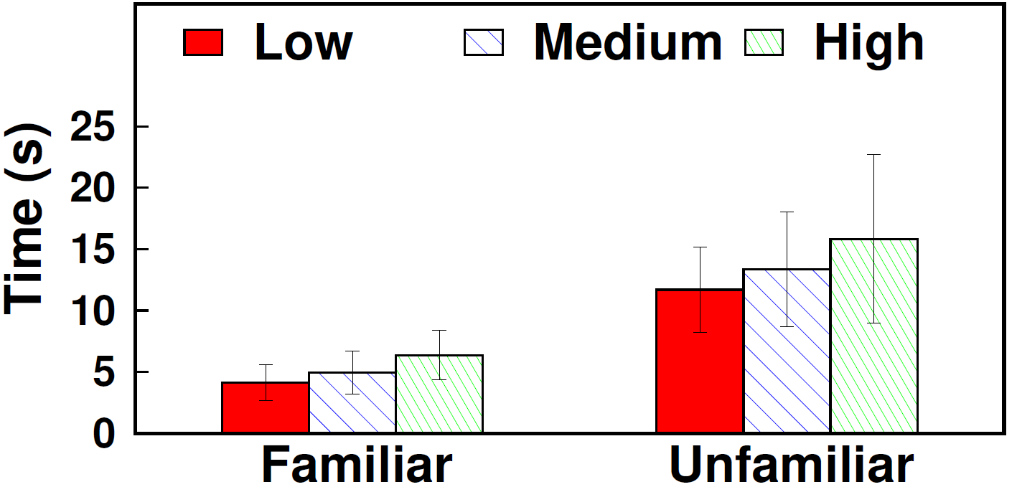
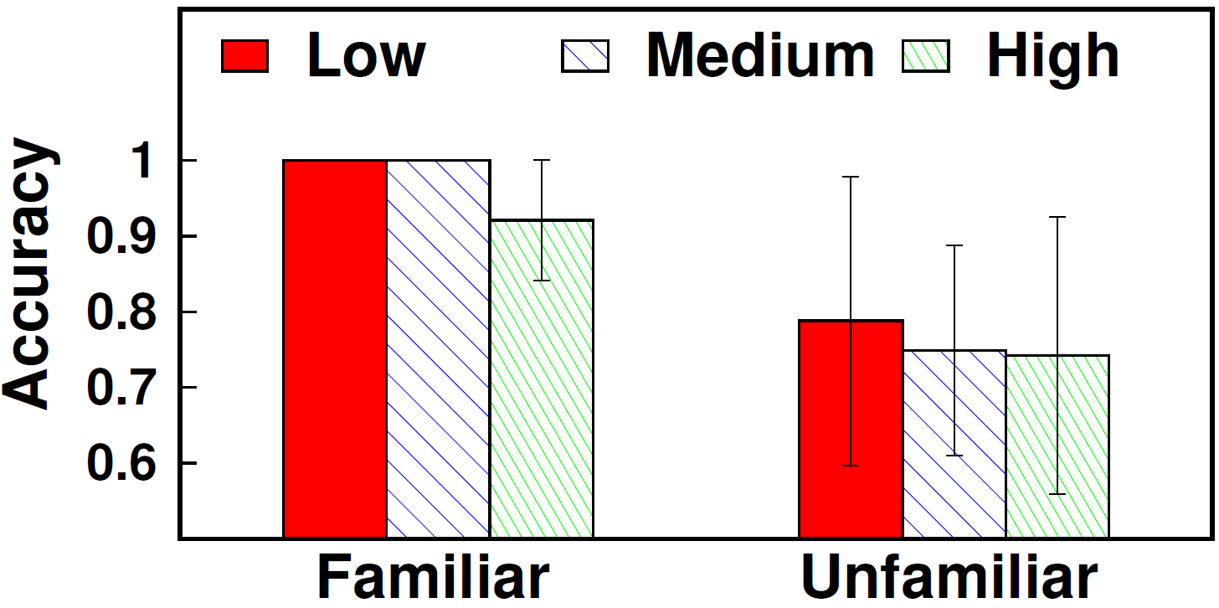
User Study Results
25 participants (age 24-32), 15 images per participant
Crowdedness level: low/medium/high
Latency increases to 16 seconds
Accuracy drops to 75%
Humans are vulnerable to cognitive overload

Slide 5
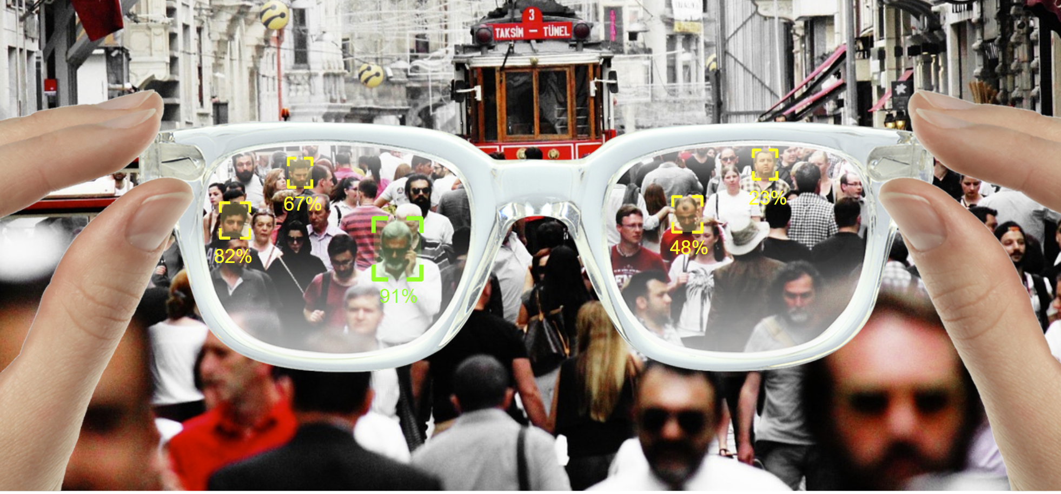
EagleEye: AR Person Identification System

Slide 6
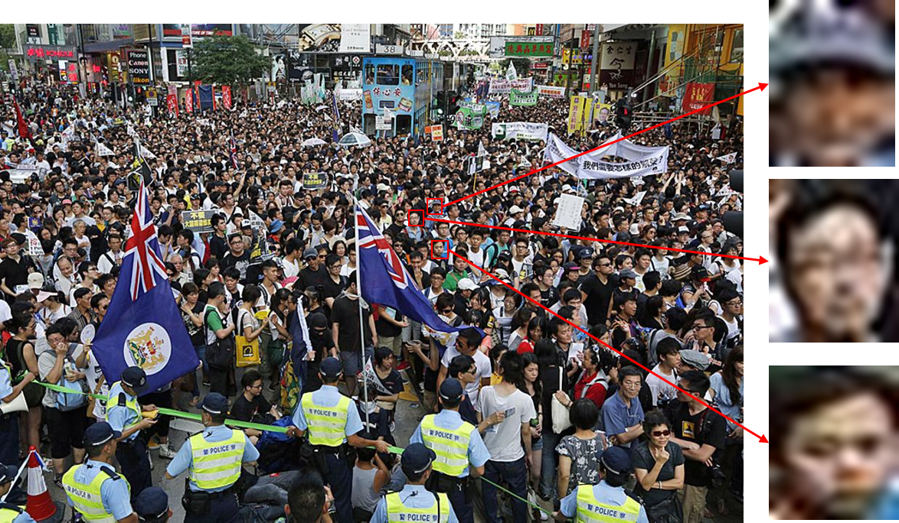
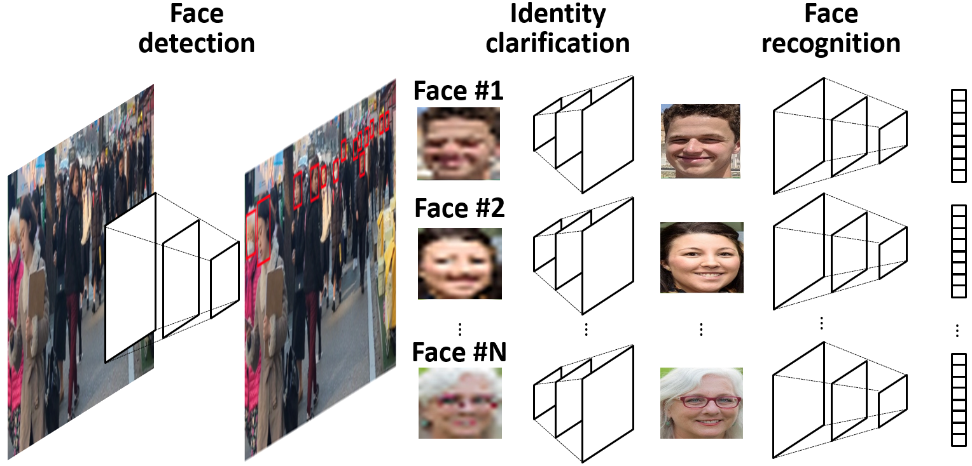
Key Challenges
How to accurately recognize small faces captured from distance?
How to run multi-DNN face identification in real-time on mobile?

Slide 7
Challenge #1: Identification Accuracy
112x112
56x56
28x28
14x14
Lack of resolution blurs the decision boundaries

Slide 8

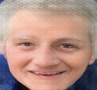




Apply Image Super-Resolution?
Existing approaches: heavily Generative Adversarial Network (GAN)-based
LR face
GAN
Ground truth
GANs reconstruct realistic faces, but do not preserve the identity

Slide 9
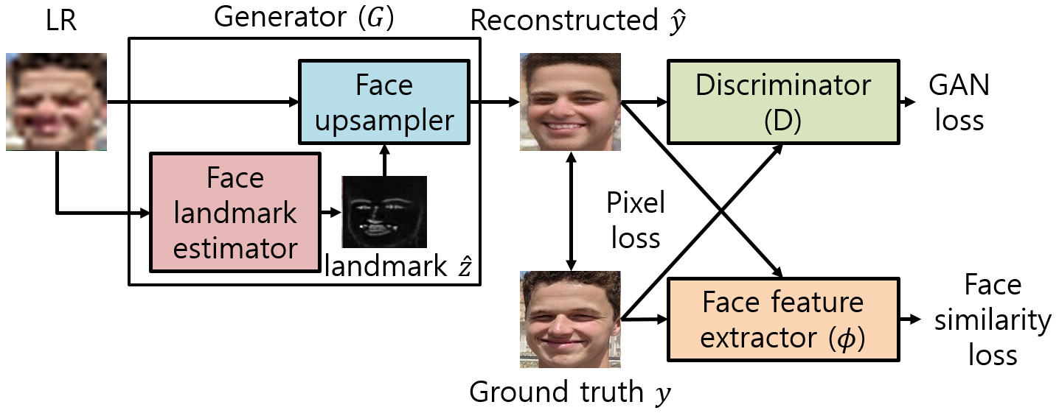
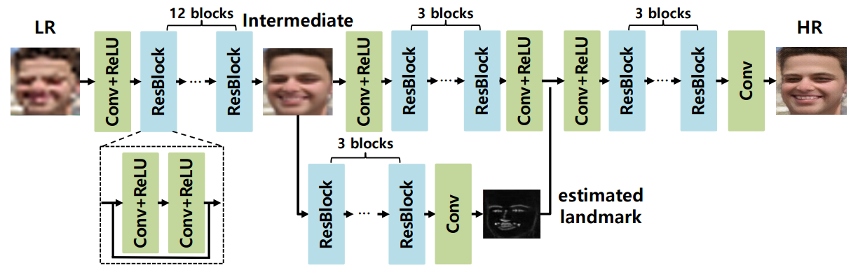
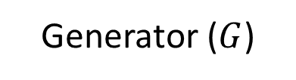
Identity Clarification Network (ICN)
Landmark-aided HR face reconstruction
Enforce reconstructed face to look realistic
Generator ($G$)
Enforce reconstructed face to preserve facial features

Slide 10
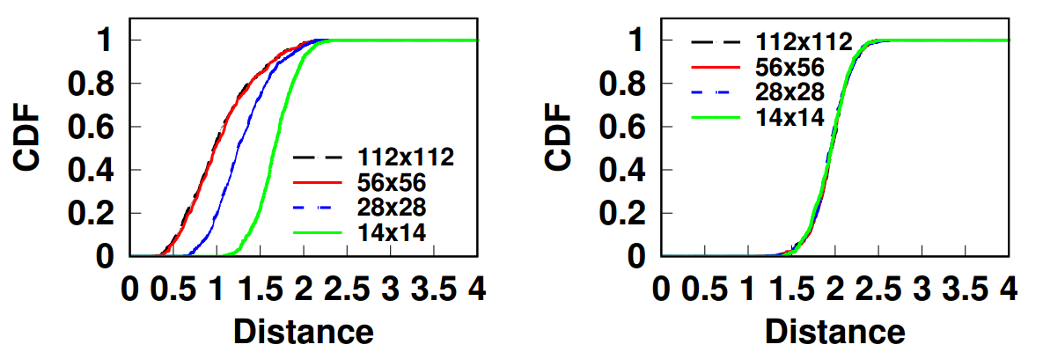
Observation for Improvements
Face feature distance for varying resolutions
Same identity pair
Different identity pair
When resolution is low, True Positive drops significantly

Slide 11







Identity-Specific Fine Tuning
Observation: we know who we are looking for
Pre-trained ICN
Reference photos
Downsampled
Reconstructed
Update weights
ICN training loss
Utilize reference photos to overfit towards the target

Slide 12
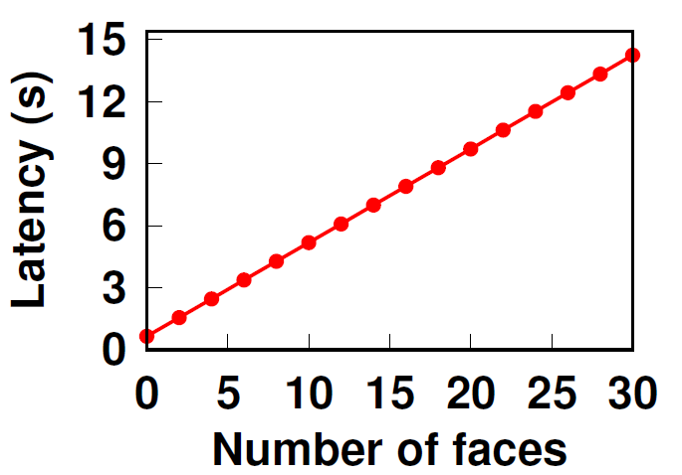
Challenge #2: Computational Complexity
648 ms per 1080p frame [1]
166 ms per 14x14 face
287 ms per 112x112 face [2]
* measured on LG V50 (Qualcomm Adreno 640 GPU) with TensorFlow-Lite
Sequential on-device execution takes 14 seconds to process a scene with 30 faces
[1] J. Deng et al., “RetinaFace: Single-stage Dense Face Localisation in the wild,” arXiv 2019.
[2] J. Deng et al., “ArcFace: Additive Angular Margin Loss for Deep Face Recognition,” CVPR 2019.

Slide 13
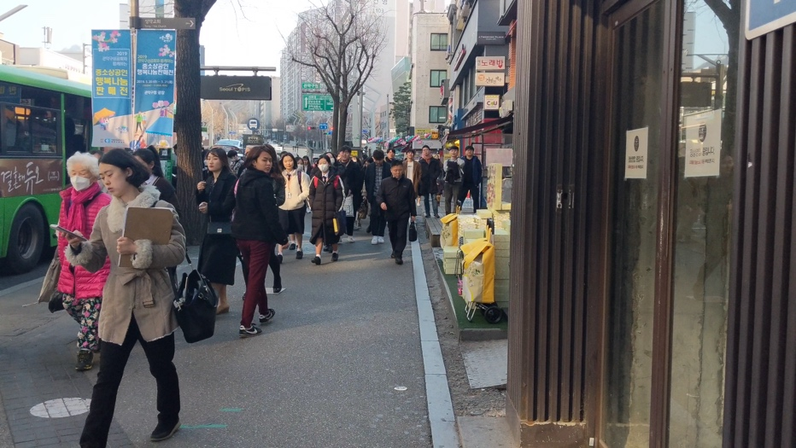
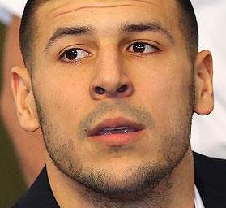
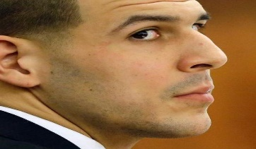
Content-Adaptive Parallel Execution
Edge-Based Background Filtering removes background regions from processing
Variation-Adaptive Face Recognition
selects pipeline based on difficulty
Spatial Pipelining processes regions in parallel over mobile and cloud

Slide 14
Content-Adaptive Parallel Execution
Edge-Based Background Filtering removes background regions from processing
Variation-Adaptive Face Recognition
selects pipeline based on difficulty
Spatial Pipelining processes regions in parallel over mobile and cloud

Slide 15
Edge-Based Background Filtering
Edges give a hint on where faces would be
Edge filtering saves 64% of computation with 2 ms overhead
Notes:
So the first step is edge-based background filtering.
The goal here is to rule out the background regions in the image to avoid unnecessary computation.
The tricky part here is that we need to do it without actually running the face detection. This is, but we have found that the edges in a scene gives a loose hint on where the faces would be
So give a scene …
Of course this edge-based filtering is not perfect, as we cannot rule out the regions with dense non-face objects like the tree, and it may actually fail on a scene full of objects. However, even in such cases, the latency of running the edge detector is typically very small and the cost will be negligible.

Slide 16
Content-Adaptive Parallel Execution
Edge-Based Background Filtering removes background regions from processing
Variation-Adaptive Face Recognition
selects pipeline based on difficulty
Spatial Pipelining processes regions in parallel over mobile and cloud

Slide 17
Variation-Adaptive Face Recognition
Recognition difficulty heavily depends on face variations
Easy
Hard
Model | Inference time | LFW (easy faces)
MobileFaceNet | 14 ms | 98.9%
ArcFace | 287 ms | 99.3%
overkill!

Slide 18
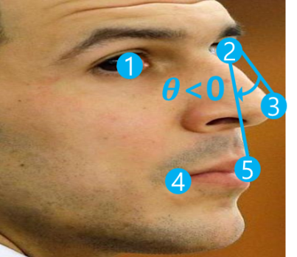
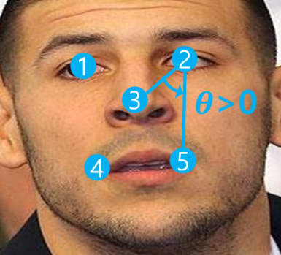
Variation-Adaptive Face Recognition
Is the resolution sufficient?
No
Yes
Is the pose frontal?
No
Yes
ICN + ArcFace
ArcFace
MobileFaceNet

Slide 19
Content-Adaptive Parallel Execution
Edge-Based Background Filtering removes background regions from processing
Variation-Adaptive Face Recognition
selects pipeline based on difficulty
Spatial Pipelining processes regions in parallel over mobile and cloud

Slide 20
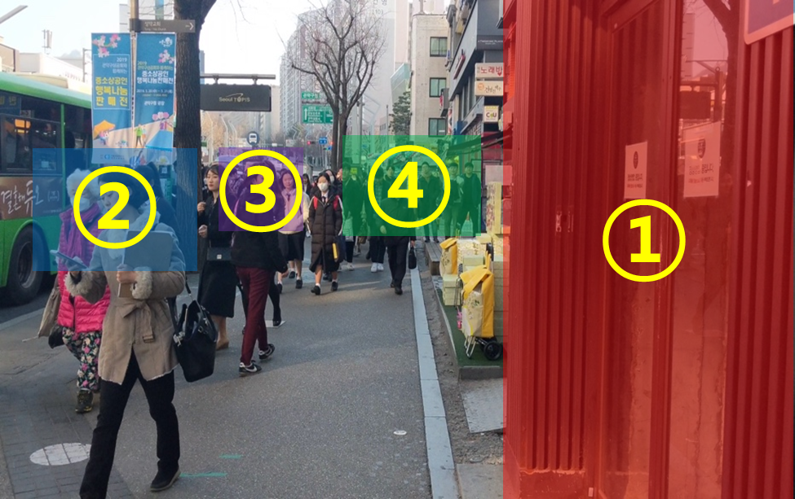
Execution Planning
① Background → Excluded
② Large, frontal faces → RetinaFace + MobileFaceNet
③ Large, profile faces
→ RetinaFace + ArcFace
④ Small faces
→ RetinaFace + ICN + ArcFace
DNNs to execute
RetinaFace
ICN
ArcFace
MobileFaceNet
Available processors
Mobile CPU
Mobile GPU
Cloud GPU
?

Slide 21
Execution Planning
High-resolution image
Large GPU memory I/O latency
High network bandwidth consumption

Slide 22
Execution Planning
High-resolution image
Mobile CPU

Slide 23
Execution Planning
High-resolution image
Mobile CPU
Proportional to the number of faces
166/287 ms per face on mobile GPU
6/7 ms per face on cloud GPU

Slide 24
Execution Planning
High-resolution image
Mobile CPU
Proportional to the number of faces
Local GPU: MobileFaceNet (18 ms)
Cloud GPU: ICN + ArcFace (6 + 7 ms)

Slide 25
Spatial Pipelining
D
Detection
Lightweight
recognition
Heavy
recognition
I+H
ICN + Heavy
recognition
L
H
Time
D
on ①
D
on ②
D
on ③
Mobile CPU
①
②
③
L
L
L
L
L
L
L
L
L
L
①
②
③
Mobile GPU
①
②
③
I +H
H
I +H
I +H
I +H
I +H
H
I +H
I +H
Cloud GPU

Slide 26
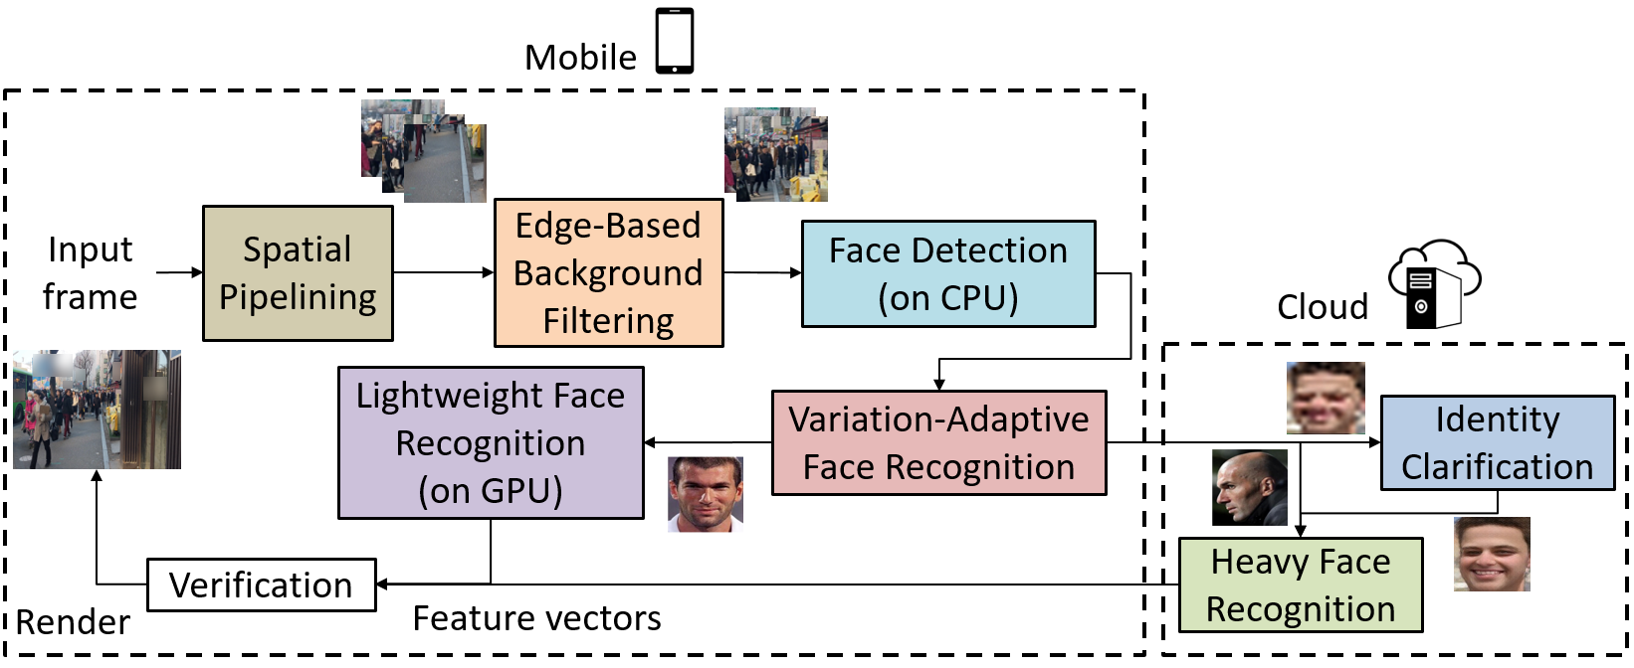
EagleEye: Putting Things Together
Divide and process in units of image blocks
Filter background blocks
Run face detection on scene
Run face recognition on detected faces

Slide 27
Evaluation
How much accuracy improvement does EagleEye achieve?
How much latency improvement does EagleEye achieve?
How effectively does EagleEye utilize mobile and cloud resources?

Slide 28
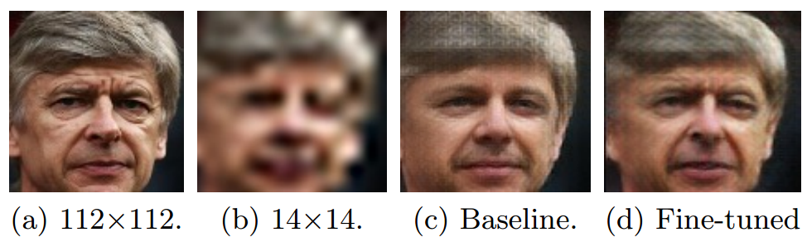
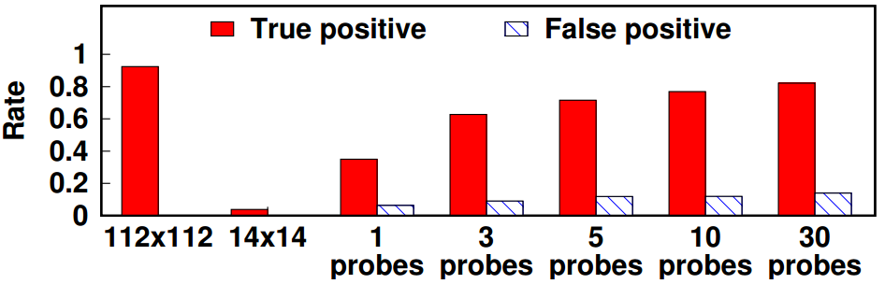
Low-Resolution Face Recognition Accuracy
ICN training dataset: Flickr-Faces-HQ (FFHQ)
Test dataset: VGGFace2
112x112
14x14
Baseline
Fine-tuned
ICN enhances True Positive by 78% at the cost of 14% False Positive

Slide 29
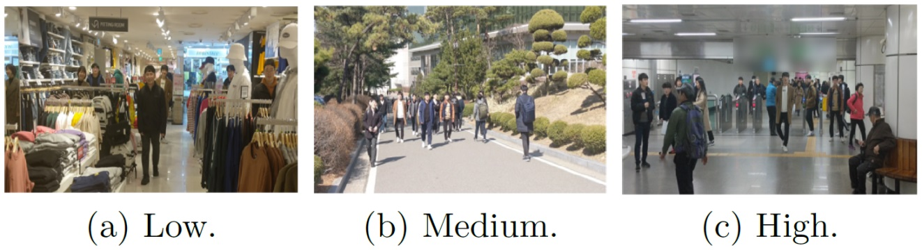
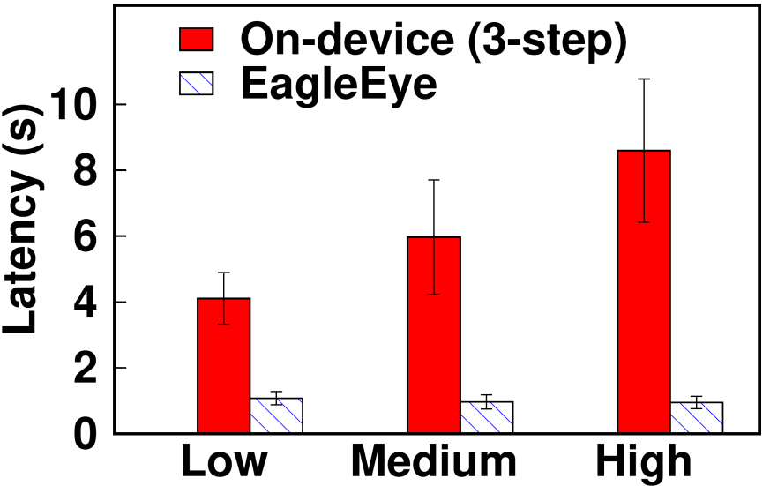
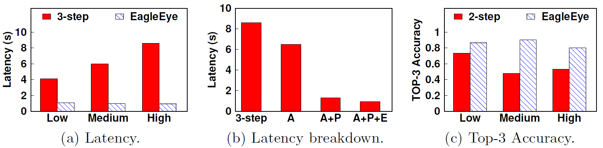
Latency on Crowded Scenes
Tested device: LG V50 (Adreno 640 GPU)
Tested LTE bandwidth: 11 Mbps
Low
Medium
High
8.6s
8.5s
6.5s
5.9s
4.1s
9.07x
1.3s
0.9s
1.0s
0.9s
0.9s
Result on a high scene with 20 faces (hard/easy faces mixed)
(A: Adaptive recognition, P: Spatial pipelining, E: Edge-based background filtering)
Latency gain increases with crowdedness (as high as 9.07x)

Slide 30
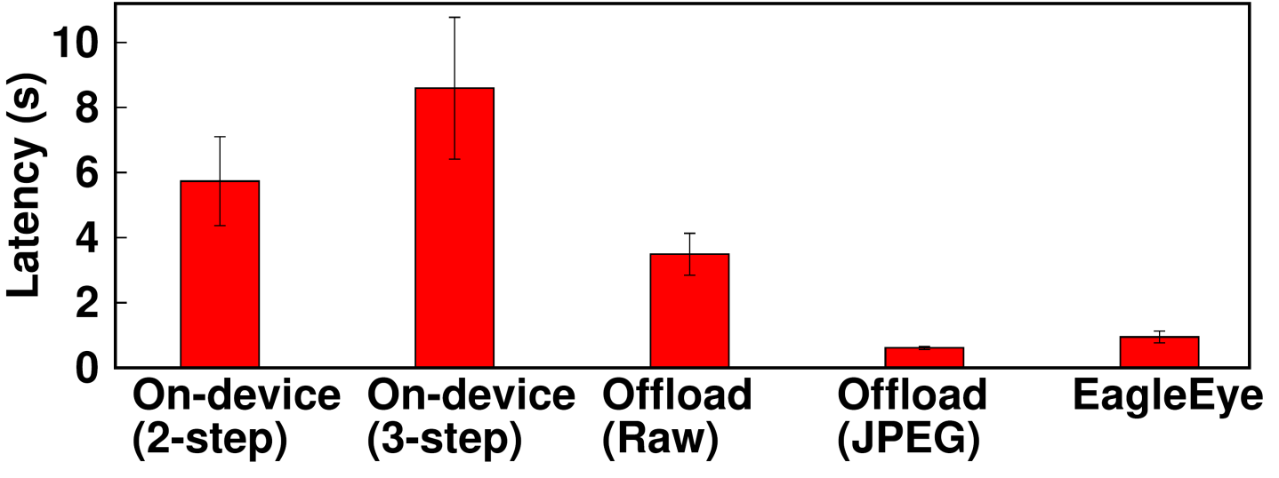
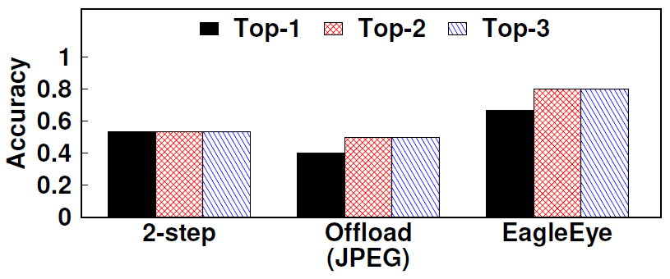
Comparison with Alternatives
Latency/accuracy on High scenes
8.5s
5.7s
3.4s
0.6s
0.9s
End-to-end latency
Top-K accuracy
EagleEye outperforms both full on-device and offloading with only 108 KBytes offloaded

Slide 31
Rooms for Improvements
Utilizing the temporal redundancy of videos
Dynamic DNN-processor mapping depending on scene contents
User interface design to utilize EagleEye as a full AR service

Slide 32
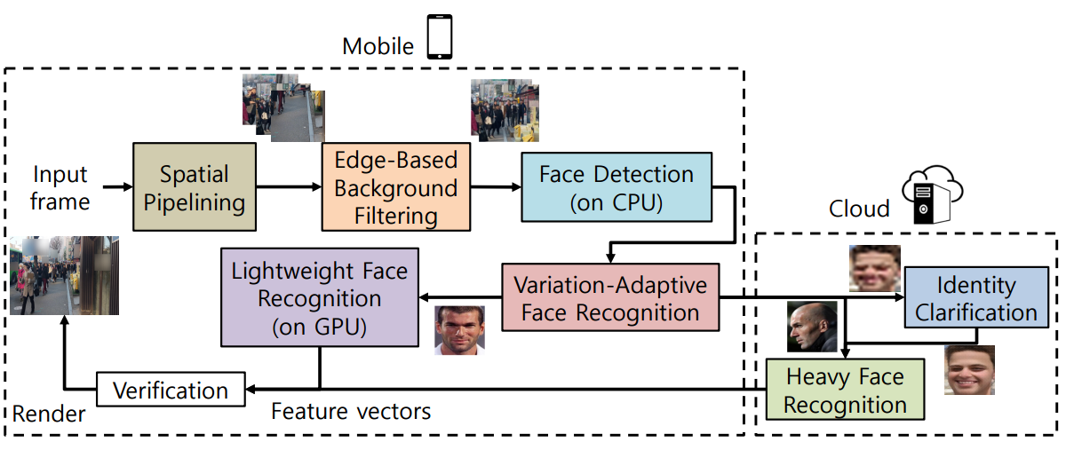
Summary
We present EagleEye, an AR-based person identification system on mobile devices
ICN enhances LR face recognition accuracy (78% gain in TP at the cost of 14% FP)
Content-Adaptive Parallel Execution enhances face identification latency by 9.07x
For more questions, contact Juheon Yi at johnyi0606@snu.ac.kr
Juheon Yi, Sunghyun Choi, and Youngki Lee, “EagleEye: Wearable camera-based person identification in crowded urban spaces”

